Slide 1
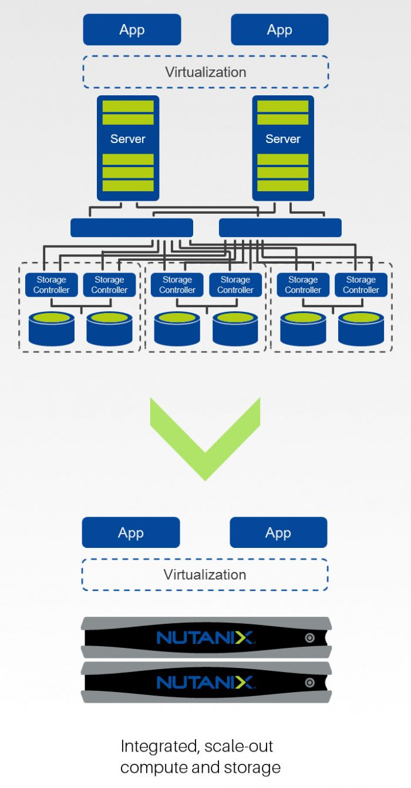
Traditional Virtualized Infrastructure
Multi-level infrastructure.
Physical Server
IP Network
Storage network
Physical Storage
SAN – Storage Area Network
Results in
Under utilized resources
Upgrades require extensive planning
Large usage of Power and rack space
Physical Disk

Slide 2

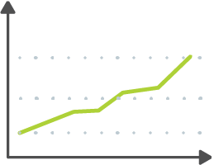

Challenges for Virtualization Management
Complexity
Scaling
Availability
  Install and Maintain
  Difficult Workflows
  Multiple Management UIs
  Complex Software Life Cycle
  Independently Scaled Application's
  Availability not built in
  Must be provisioned and managed separately
Time and effort is wasted managing the management solution
Notes:
Legacy virtualization solutions include:
Complexity
HW independent Hypervisor – Must be universal to work on “ANY” hardware.
A separate VM management solution (e.g. vCenter or Microsoft SCOM)
VMW requires MULTIPLE management solutions. vCenter for basics, then vROPS, and vRA for monitoring and automation. - Nutanix provides all of this via Prism.
Software life cycle in independent for all the above products. Guide for vSphere products upgrade has many steps and specific order of operations to ensure continued operation of the suite
Scaling
With vSphere, for example, vCenter has multiple deployment models (stand alone & Appliance). They are moving towards appliance being standard but for orgs with multiple versions of ESX or large existing vCenter deployments the migration is complex. Then there is the periphery of additional apps required for monitoring & capacity planning (vCOPS Log Insight etc). These tools have their own requirements for scaling and software upgrades.
Availability
Similar to above, the vCenter Appliance (VCSA) now has some availability but the other deployment model does not. Apps like vCOPS etc are not accounted for and must have a separate availability plan.
WHY is this important?
Reflecting on what Nutanix initially did with WebScale HCI, the 3-tier stack was simplified. Excess management and complexity of legacy architecture removed. This translated into cost and operational efficiency.
With AHV we continue that trend at the virtualization layer. VMW and HyperV are also a legacy architecture designed for a 3-tier HW Centric world. Nutanix is software defined and by using AHV additional complexity and cost is removed. Nutanix Acropolis on AHV is much closer to a public cloud architecture that also focuses on services and not HW. (e.g AFS, ABS, SSP)
Prism provides most of the required management, monitoring, and capacity planning features. Prism and Prism Central scale simply and upgrade easily.

Slide 3
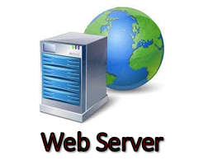
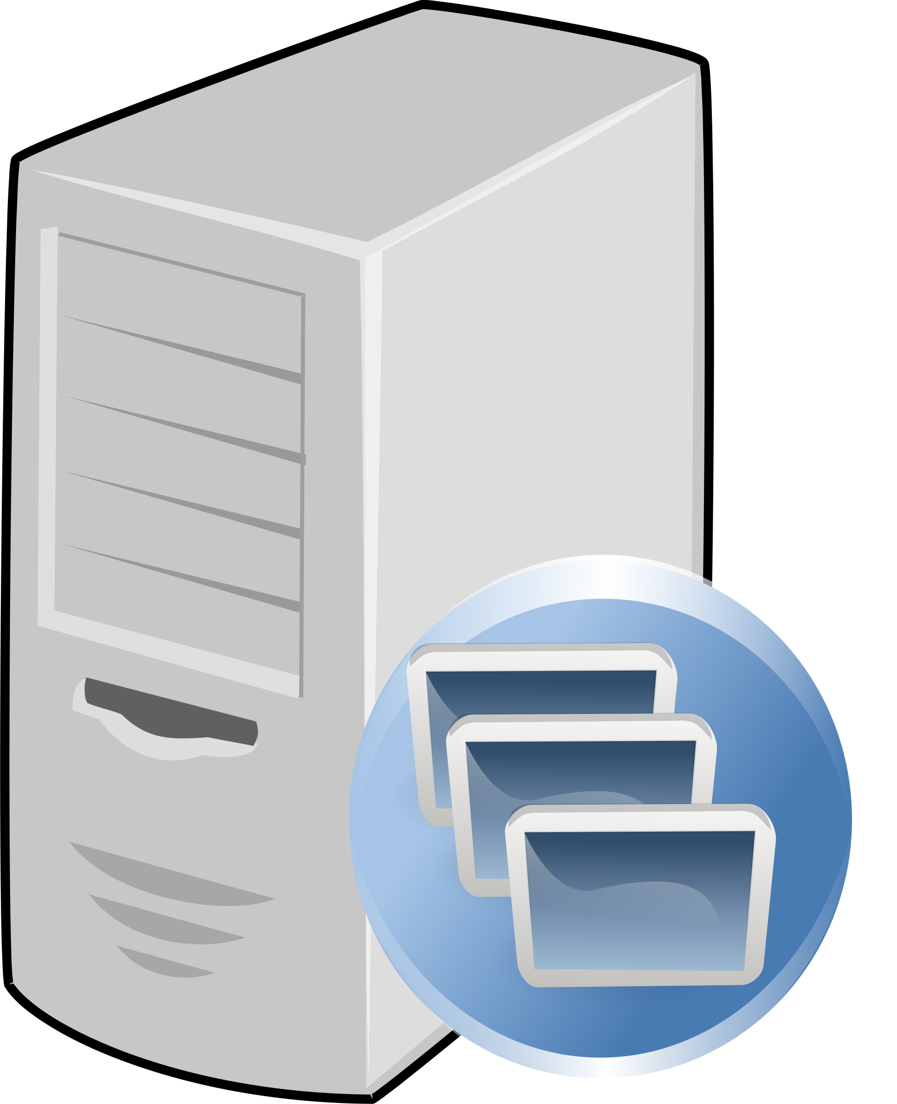
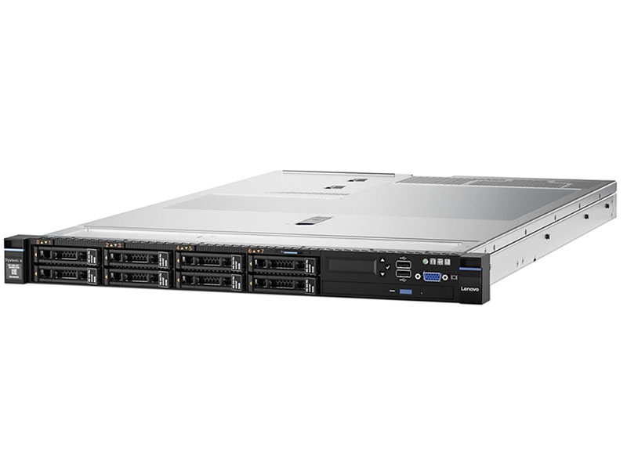
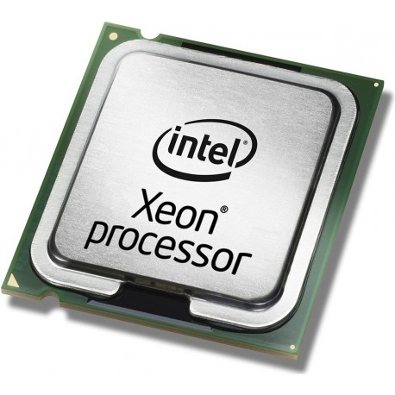
Nutanix X86 Hyperconverged Infrastructure
App Server
SAN – Storage Area Network
Physical Disk
X86 Running Linux or Windows Operating Systems -> Compute, Networking and Storage are converged into a single layer

Slide 4
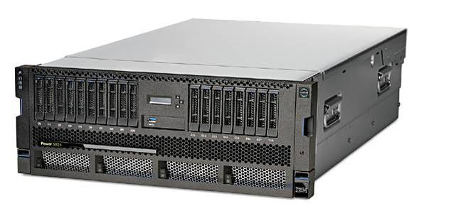
What about workloads running on IBM Power Systems?
AIX which is developed and supported by IBM, is often the preferred choice for Enterprise level customers running large database and data warehouse servers. These are typically tier one mission critical servers than cannot tolerate any downtime.
The design of these systems runs what is known as a three tier application. Tier one being the database server running on AIX providing the best I/O, availability and security. The Second tier is the Application Level which interacts with the database tier. Typically this second tier will run on a Linux based operating system. The third tire is the Web Server, this tier also has a tendency to run in a Linux environment.
All three of these tiers can be run and managed on an IBM Power system.
Database Servers
AIX LPAR
Application Servers
Linux LPAR
Web Servers
Linux LPAR

Slide 5
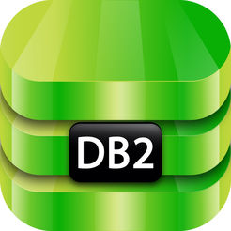
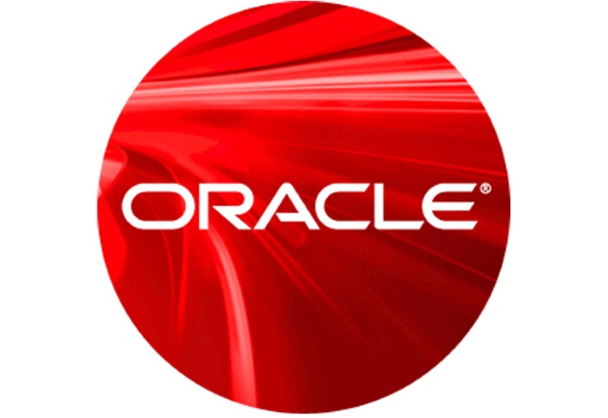
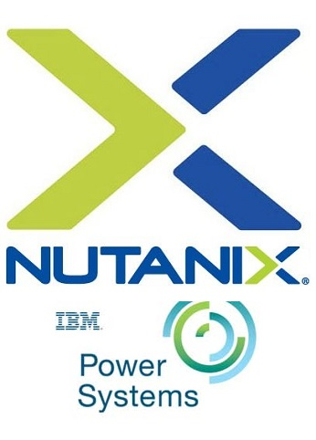
Nutanix now on IBM POWER - Hyperconverged Infrastructure
IBM Power 9
SAN – Storage Area Network
Physical Disk
Compute, Networking and Storage are converged into a single layer
IBM POWER Data Base Servers Running AIX or LINUX
Compute, Networking and Storage are virtualized but not converged

Slide 6
All three of these tiers could run on IBM Power Systems and be managed under a single pane of glass using IBM Power VM
IBM Power Systems
However, Linux can run in either an IBM Power environment or on an X86 infrastructure.
Database Server
Application Servers
Web Servers
How can you mange all of these workloads together ?

Slide 7
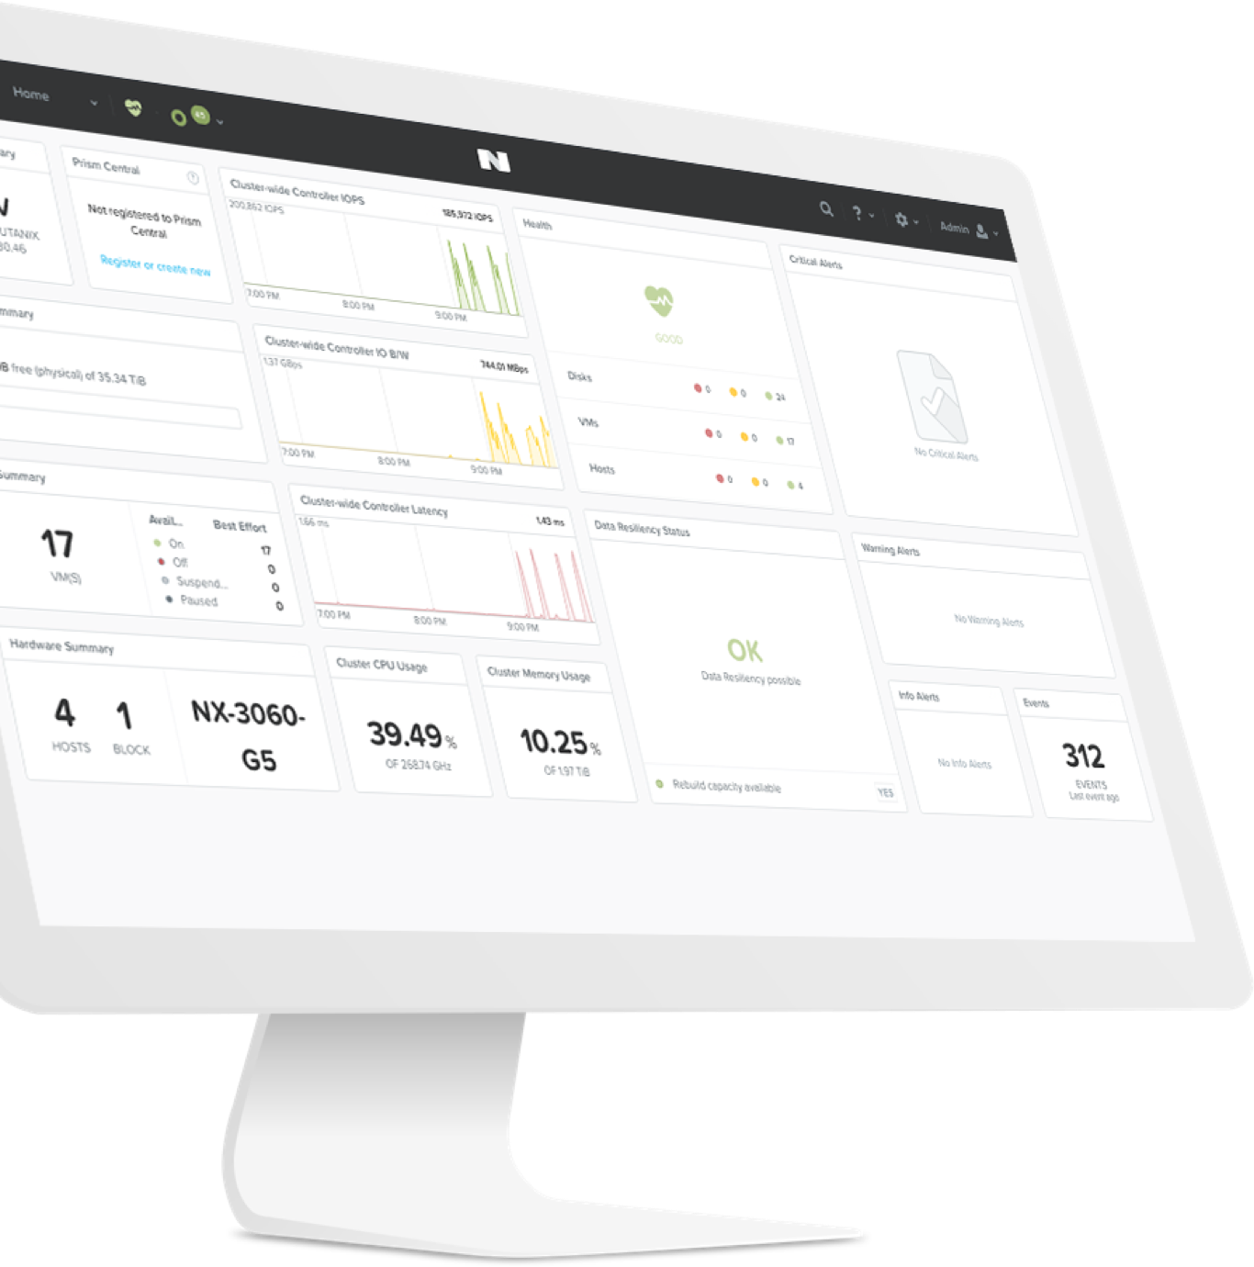
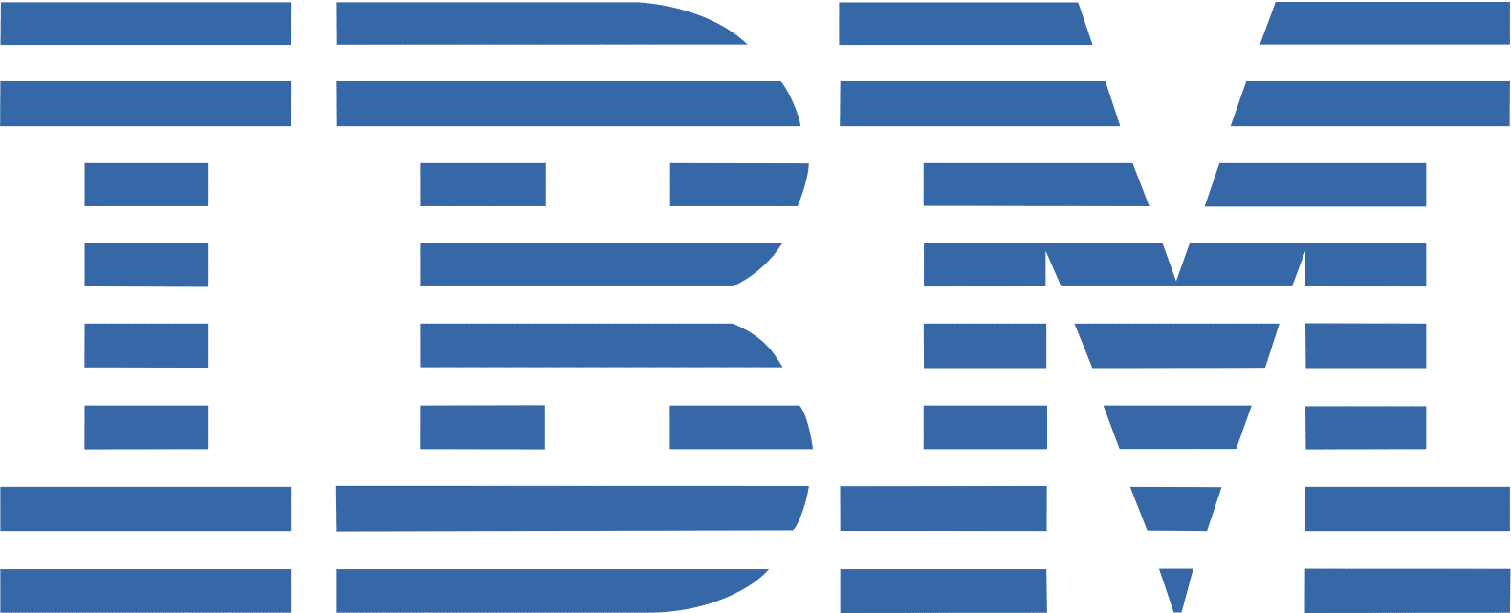
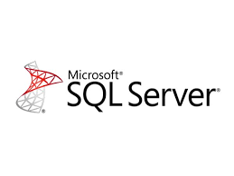
IBM POWER SYSTEMS
Managed in a Single Pane of Glass Nutanix Prism One
Lets Combine it all together
Intel / X86
App Server

